Slide 1


Python Machine Learning
Žydrūnė Kelpšaitė
Data Analyst

Slide 2
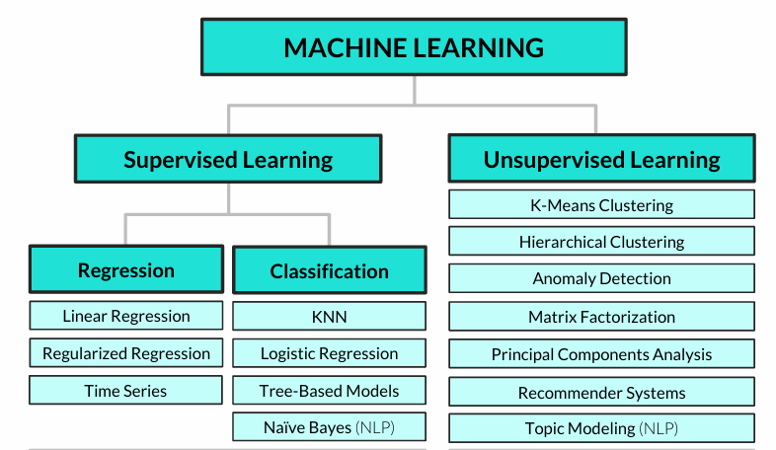
Common machine learning algorithms

Slide 3
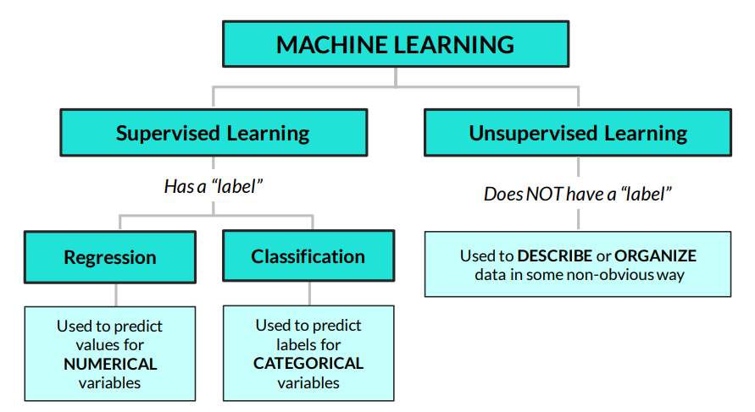
UNSUPERVISED LEARNING 101
Unsupervised learning is about finding insights & patterns hidden in the data
• Unlike regression or classification, we don’t care about splitting our data into train / test sets and making predictions, we just care about understanding the relationships in our data

Slide 4
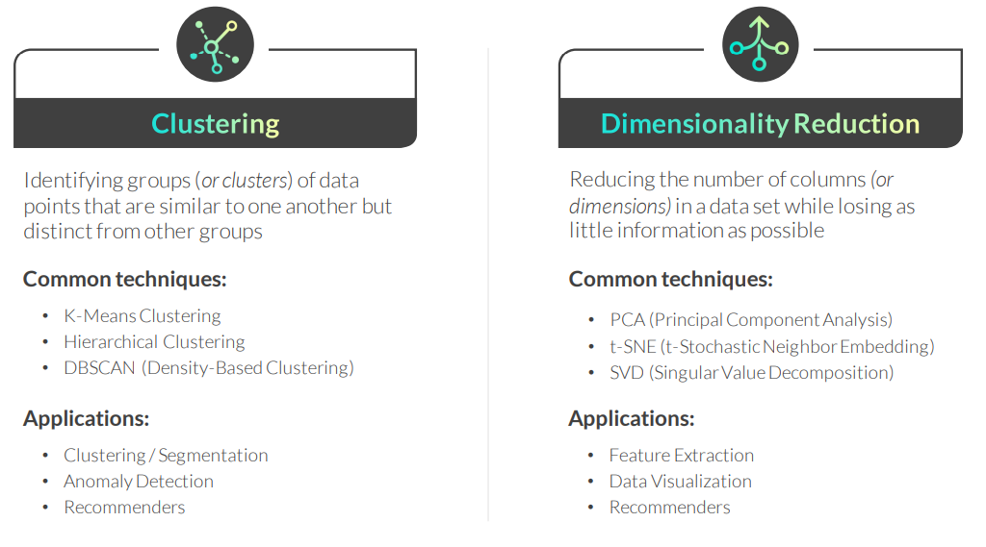
UNSUPERVISED LEARNING TECHNIQUES
There are two popular categories of unsupervised learning techniques:

Slide 5
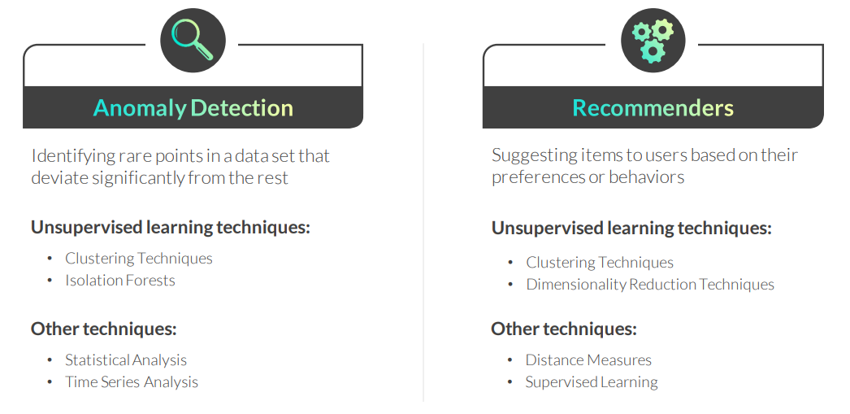
UNSUPERVISED LEARNING APPLICATIONS
These are two common applications of unsupervised learning techniques:

Slide 6
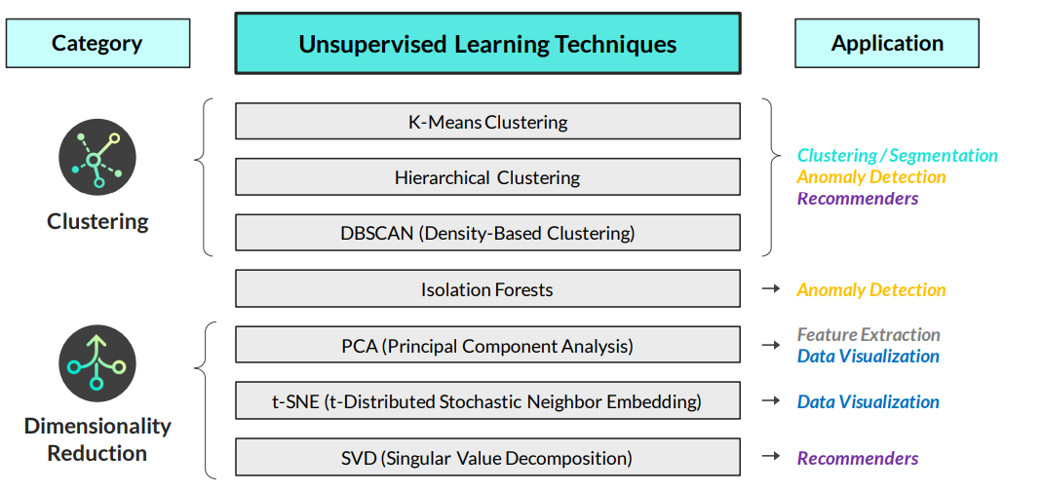
Unsupervised learning techniques & applications

Slide 7
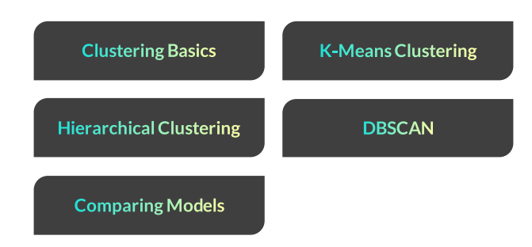
CLUSTERING

Slide 8
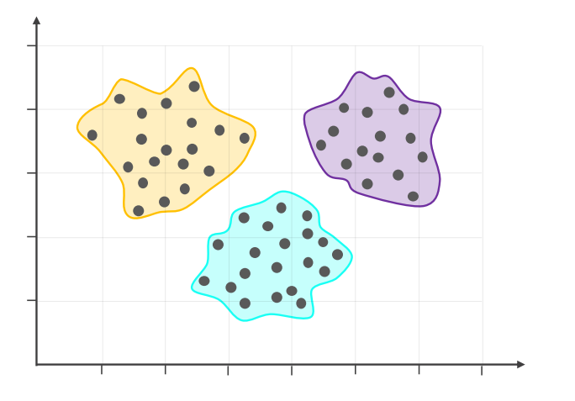
CLUSTERING BASICS
Clustering allows to find concentrations or groups of observations which are similar to one another but distinct from other groups

Slide 9
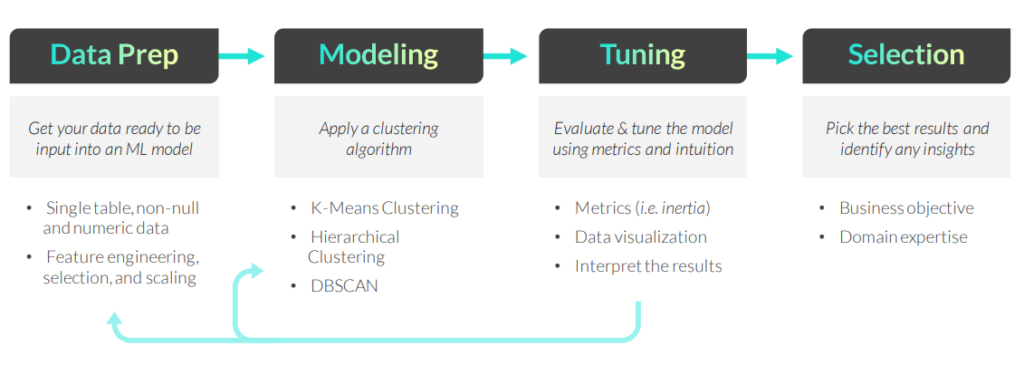
CLUSTERING WORKFLOW
The general clustering workflow consists of the following steps:
Remember, there’s no “right” answer or single optimization metric when it comes to clustering; the best outputs are the ones which help you answer the question at hand and make practical, data-driven business decisions

Slide 10
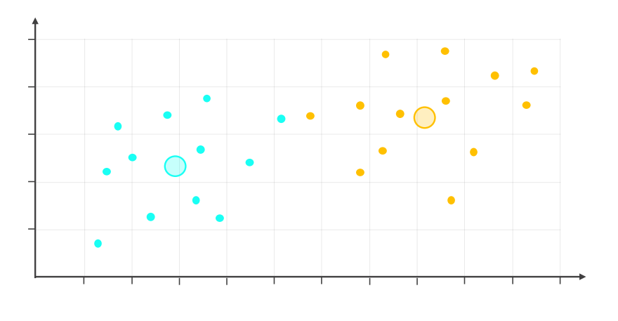
K-MEANS CLUSTERING
K-Means Clustering is a popular algorithm which assigns each observation in a data set to a specific cluster, where “K” represents the number of clusters
Notes:
Čia K=2

Slide 11
K-MEANS CLUSTERING
K-Means Clustering is a popular algorithm which assigns each observation in a data set to a specific cluster, where “K” represents the number of clusters
Here’s how it works:
Select “K” arbitrary locations in a scatter plot as cluster centers (or centroids), and assign each observation to a cluster based on the closest centroid
Recalculate and relocate each centroid to the mean of the observations assigned to it, then reassign each observation to its new closest centroid
Repeat the process until observations no longer change clusters
Example use cases:
• Identifying customer segments for targeted marketing campaigns
• Clustering store locations based on factors like sales, ratings, size, etc

Slide 12
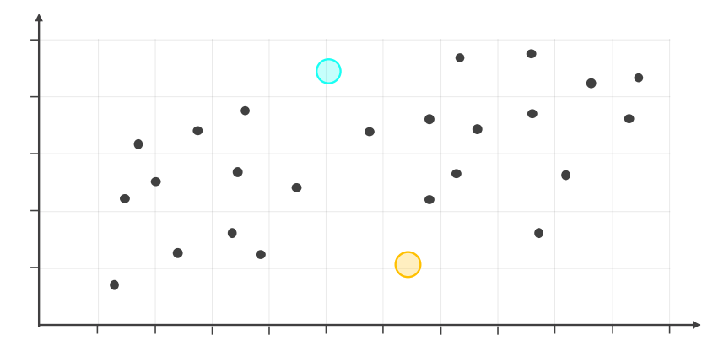
K-MEANS CLUSTERING
STEP 1: Determine what you think might be an appropriate number of clusters (in this case 2), and select arbitrary locations as initial centroids
Notes:
K = 2

Slide 13
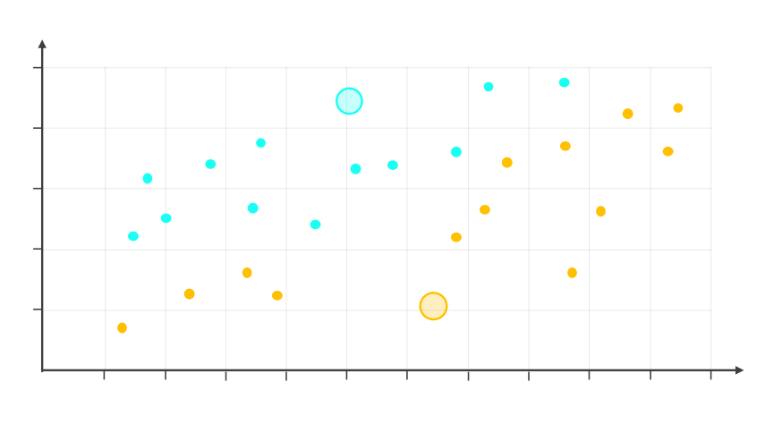
K-MEANS CLUSTERING
STEP 2: Assign each observation to a cluster, based on the closest centroid

Slide 14
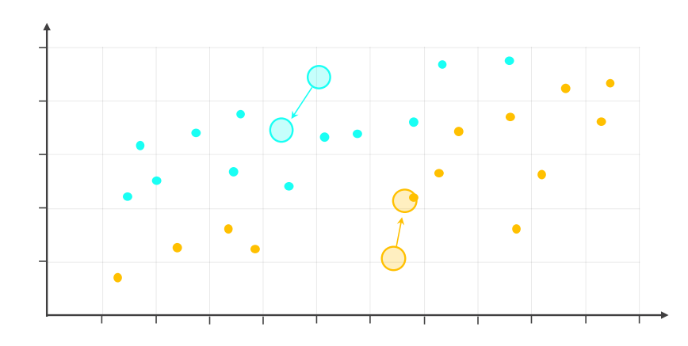
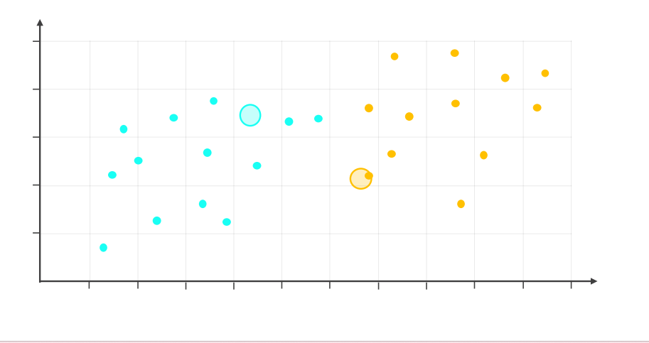
K-MEANS CLUSTERING
STEP 3: Relocate each centroid to the mean of its assigned observations, and reassign each observation to the new closest centroid

Slide 15
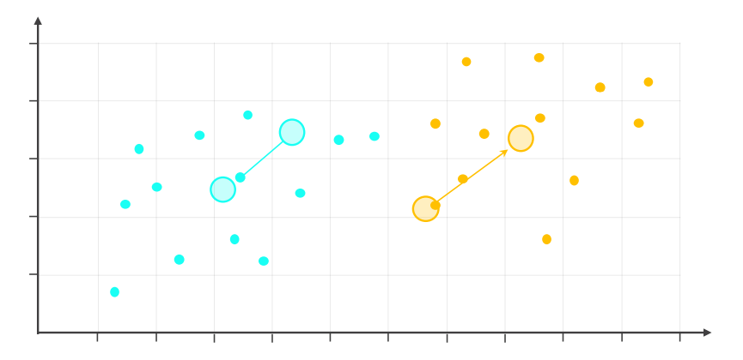
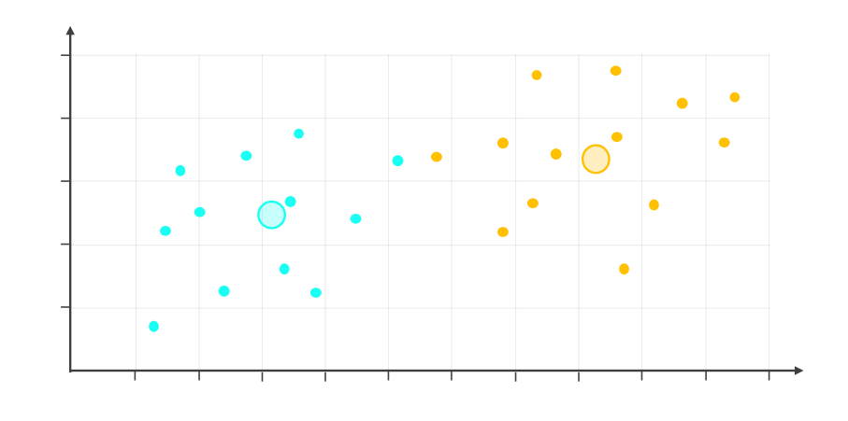
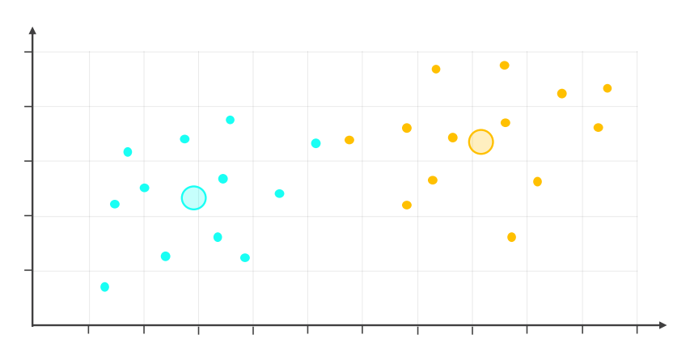
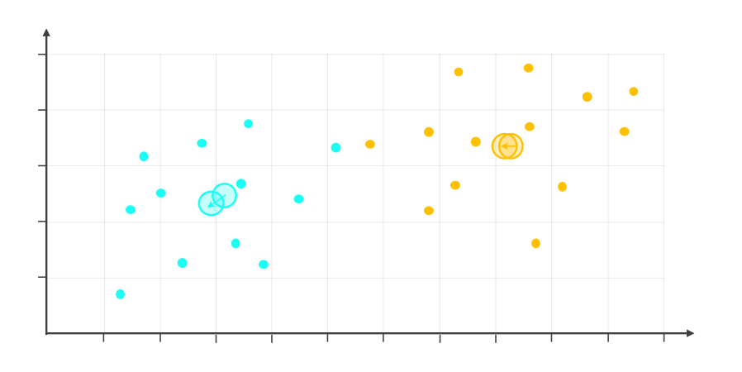
K-MEANS CLUSTERING
STEP 4: Continue to relocate each centroid to the mean of its assigned observations, until the clusters no longer change

Slide 16
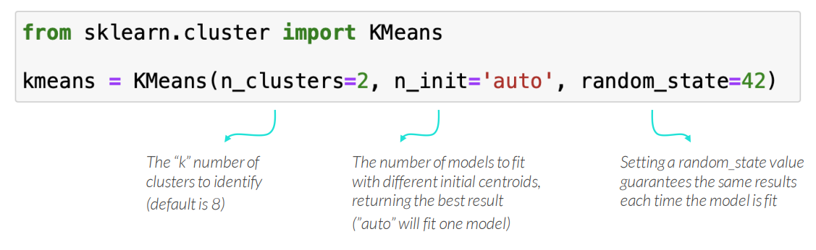
K-MEANS CLUSTERING IN PYTHON
Use sklearn’s KMeans()function to perform K-Means Clustering
PRO TIP: It’s typically a good idea to start with 2 clusters and build up from there, comparing the results

Slide 17
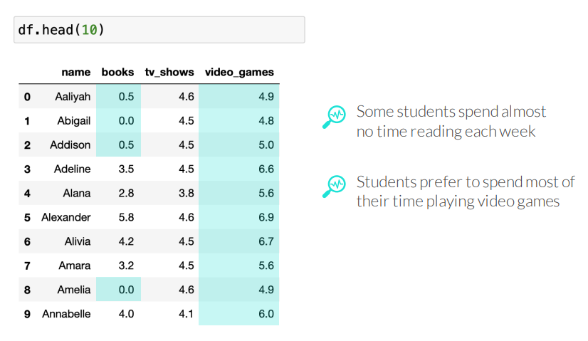
K-MEANS CLUSTERING IN PYTHON
EXAMPLE: Clustering high school students based on entertainment preferences so the local library can use targeted ads to encourage teenagers to read more

Slide 18
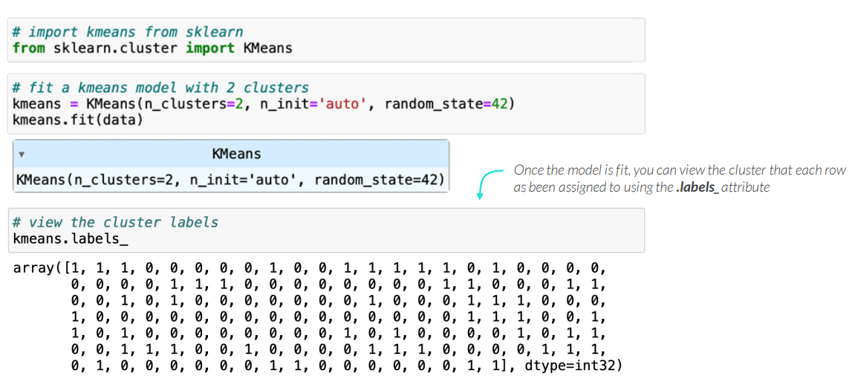
K-MEANS CLUSTERING IN PYTHON
EXAMPLE: Clustering high school students based on entertainment preferences so the local library can use targeted ads to encourage teenagers to read more

Slide 19
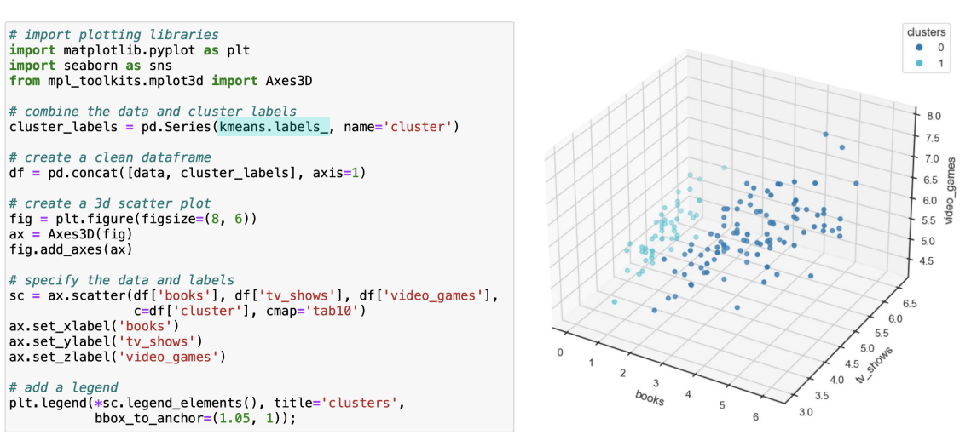
VISUALIZING K-MEANS CLUSTERING
You can visualize the results of a K-Means model using the .labels_ attribute and data visualizations libraries in Python
Notes:
https://www.geeksforgeeks.org/python/3d-scatter-plotting-in-python-using-matplotlib/
https://matplotlib.org/stable/gallery/mplot3d/scatter3d.html

Slide 20
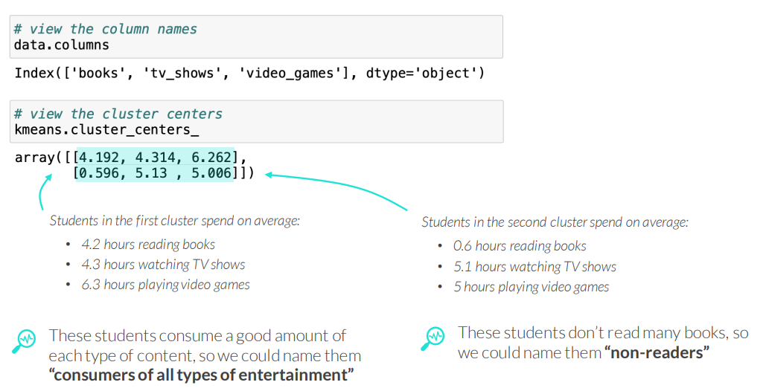
VISUALIZING K-MEANS CLUSTERING
You can interpret the results of a K-Means model using the .cluster_centers_ attribute and data visualizations libraries in Python

Slide 21
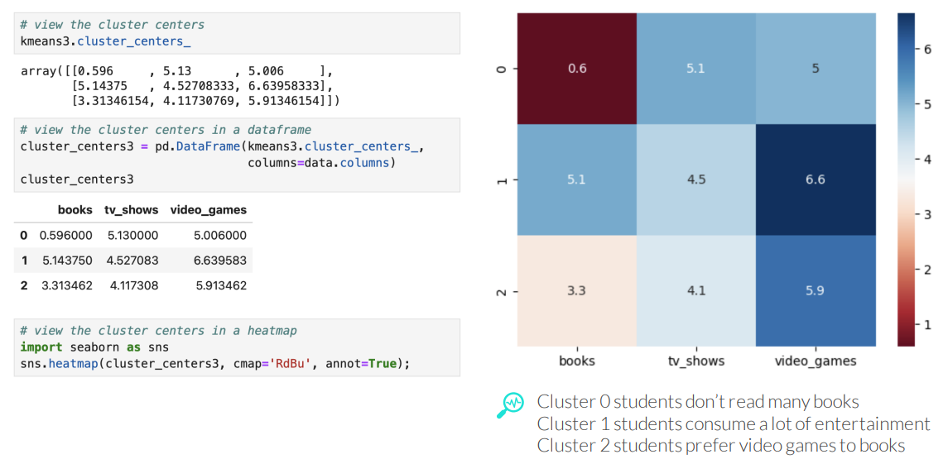
VISUALIZING K-MEANS CLUSTERING
Visualizing the cluster centers in a heat map can help interpret them

Slide 22
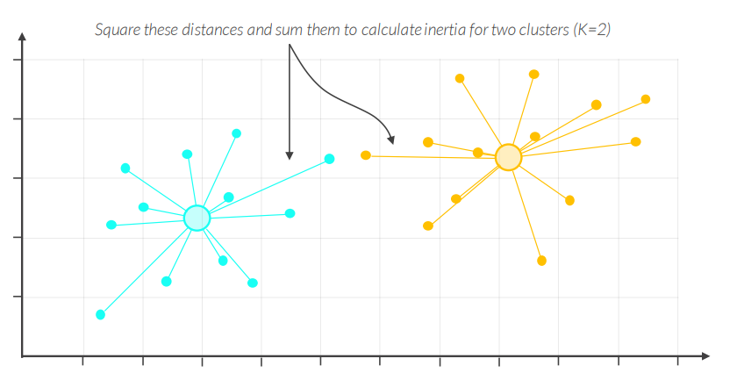
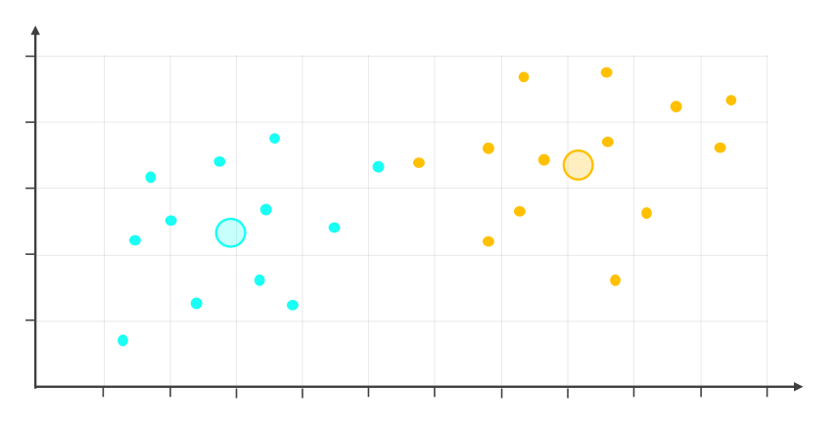
INERTIA
How do we know what’s the “right” number of clusters (K)?
• While there is no “right” or “wrong” number of clusters, you can use the inertia (aka within-cluster sum of squares or WCSS) to help inform your decision

Slide 23
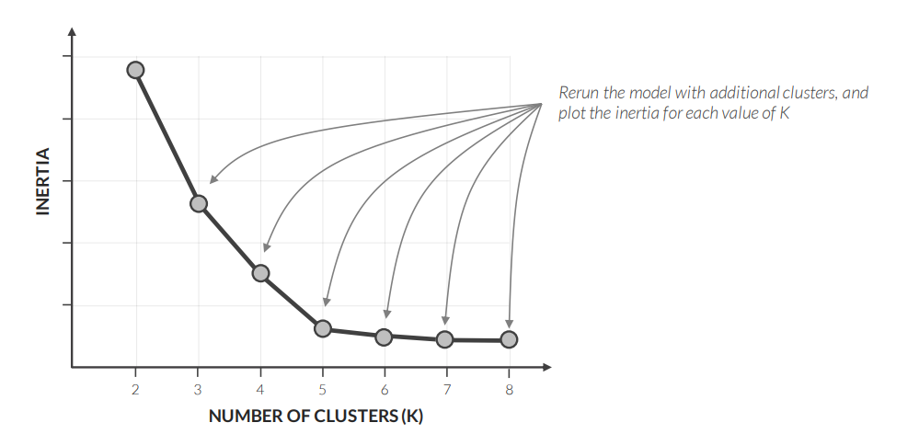
INERTIA
How do we know what’s the “right” number of clusters (K)?
• While there is no “right” or “wrong” number of clusters, you can use the inertia (aka within-cluster sum of squares or WCSS) to help inform your decision
Notes:
Didinant K, inertia mažėja. Tačiau ties tam tikra vieta mažėjimas tampa gerokai lėtesnis – susidaro „alkūnė“. Šiame pavyzdyje ji ties K ≈ 5.

Slide 24
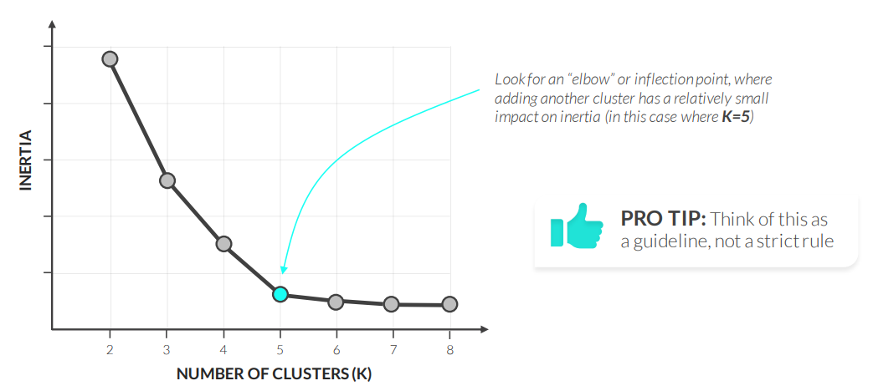
INERTIA
How do we know what’s the “right” number of clusters (K)?
• While there is no “right” or “wrong” number of clusters, you can use the inertia (aka within-cluster sum of squares or WCSS) to help inform your decision
Notes:
https://www.w3schools.com/python/python_ml_k-means.asp

Slide 25
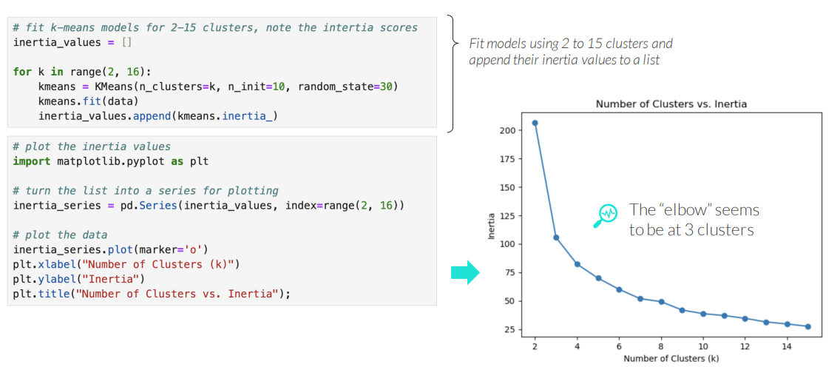
PLOTTING INERTIA IN PYTHON
You can plot inertia in Python by fitting K-Means models with different values for “k”, storing the inertia for each one, and visualizing the results
Notes:
X ašis – klasterių skaičius K. Y ašis – inertia.
Matyti, kad didžiausias kritimas yra tarp 2 ir 3 klasterių, o po 3 mažėjimas tampa lėtesnis. Todėl „alkūnė“ šiame pavyzdyje ties K ≈ 3.

Slide 26
TUNING A K-MEANS MODEL
Part of the clustering workflow is to go back to various data prep and modeling steps to tune a model before selecting the best one
Data Prep
• Data cleaning: Removing outliers, etc.
• Feature engineering: Creating relevant features, etc.
• Feature selection: More features does not mean a better model!
• Scaling: K-Means is a distance-based algorithm, so it’s a good idea to scale the data
Modeling
• Trying a different number of clusters: If your clusters are very different with each run, K-Means with that specific number of clusters may not be the best fit for your data, so try using a different number of clusters
• Trying other clustering models: K-Means works best when the clusters are mostly circular in shape, but algorithms like Hierarchical Clustering can address this

Slide 27
SELECTING THE BEST MODEL
There is no definitive best model when clustering, but a good model has clusters that make sense, capture patterns, and help solve the business problem
Explore the clusters using data-based approaches such as
• Comparing the cluster assignments for the data set and individual rows of data
• Comparing metrics of the various models – inertia, silhouette score, etc.
• Testing the clustering models on unseen data
PRO TIP: Sometimes the exact cluster assignments don’t matter as much as the actionable recommendations you can make based on the clustering models

Slide 28
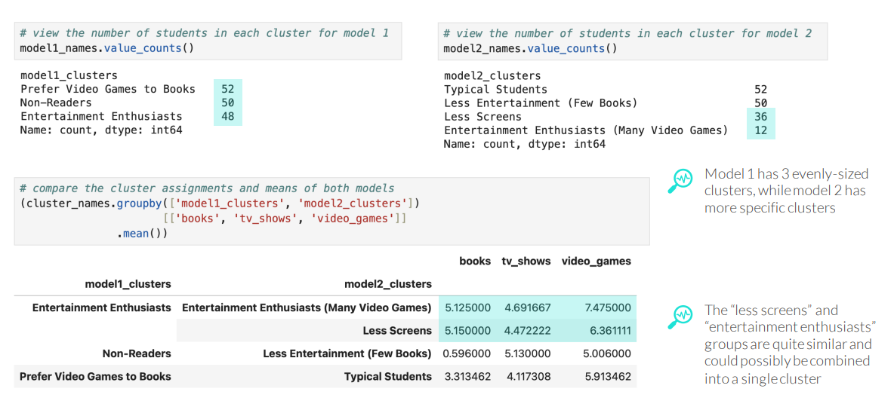
SELECTING THE BEST MODEL
EXAMPLE: Clustering high school students based on entertainment preferences so the local library can use targeted ads to encourage teenagers to read more

Slide 29
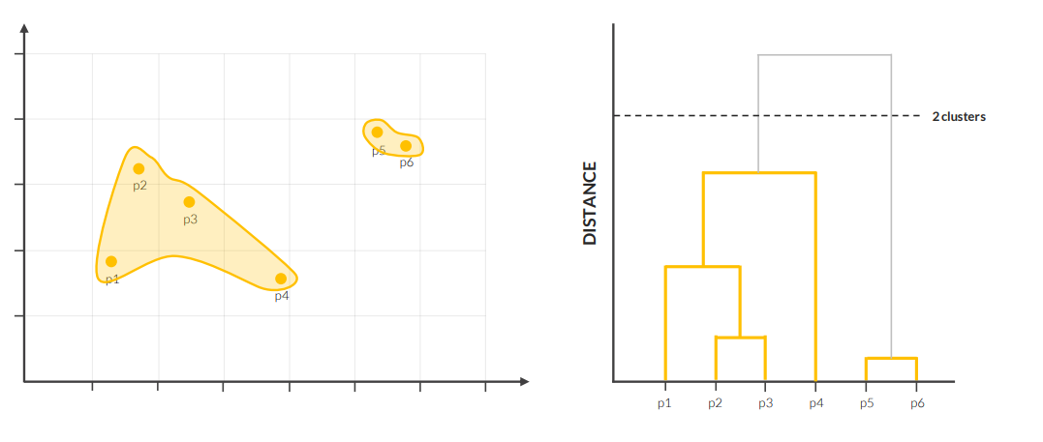
HIERARCHICAL CLUSTERING
Hierarchical Clustering is a clustering technique that creates clusters by grouping similar data points together

Slide 30
HIERARCHICAL CLUSTERING
Hierarchical Clustering is a clustering technique that creates clusters by grouping similar data points together*
Here’s how it works:
Within a scatter plot, find the 2 closest points, and group them into a cluster
Then find the next two closest points or clusters, and group them to a cluster
Repeat the process of combining the closest pairs of points or clusters until you eventually end up with one single cluster
This process is visualized using a tree diagram called a dendrogram, which shows the hierarchical relationship between clusters
*This is known as agglomerative or “bottom-up” clustering (vs. divisive or “top-down” clustering, which is much less common)

Slide 31
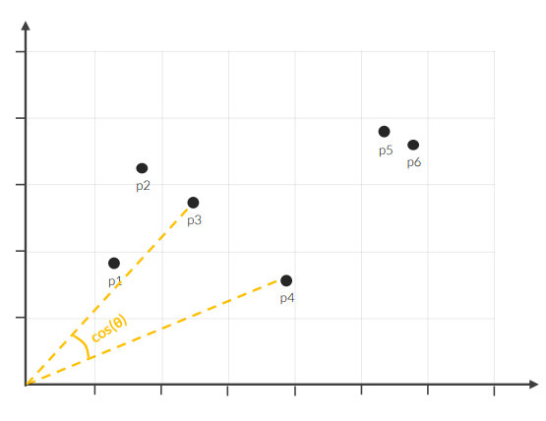
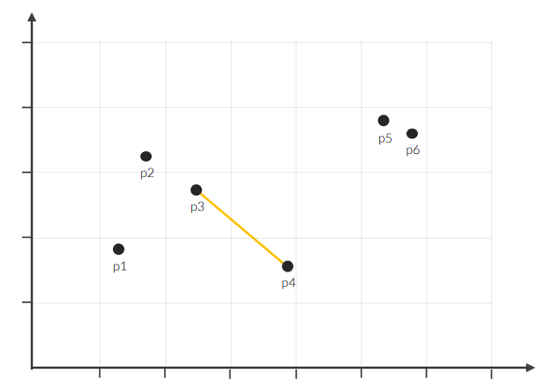
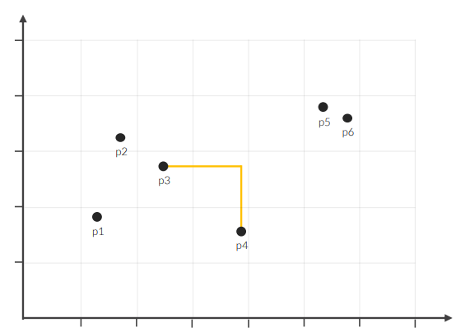
HIERARCHICAL CLUSTERING
STEP 1: Find the two closest points, and group them into a cluster
Euclidean distance
Manhattan distance
Cosine distance

Slide 32
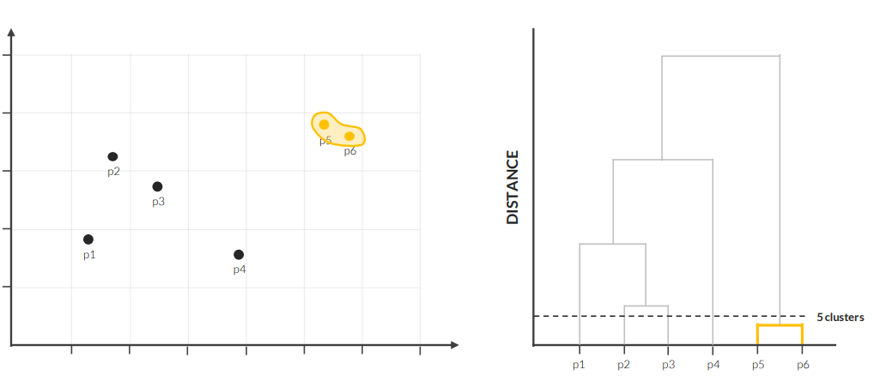
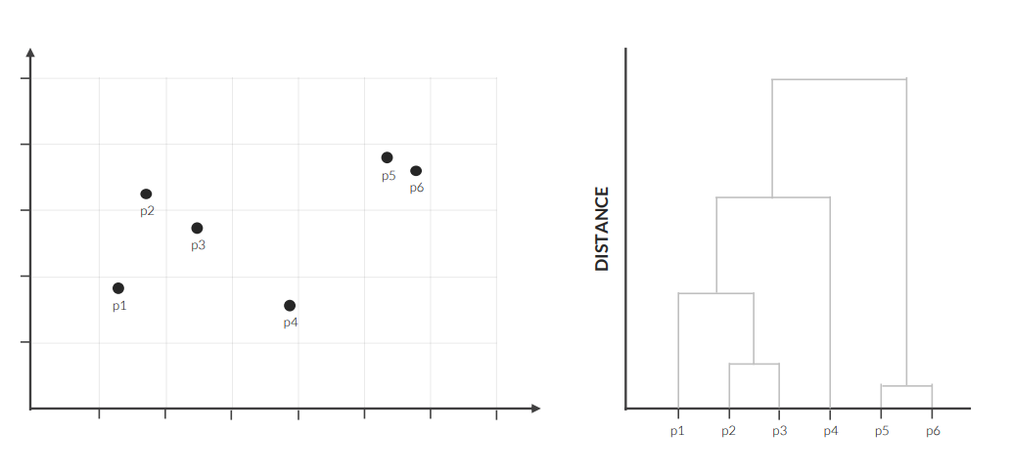
HIERARCHICAL CLUSTERING
STEP 1: Find the two closest points, and group them into a cluster

Slide 33
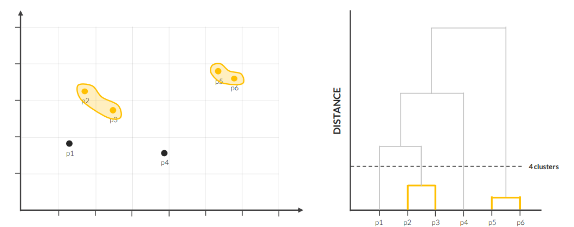
HIERARCHICAL CLUSTERING
STEP 2: Find the next two closest points/clusters, and group them together

Slide 34
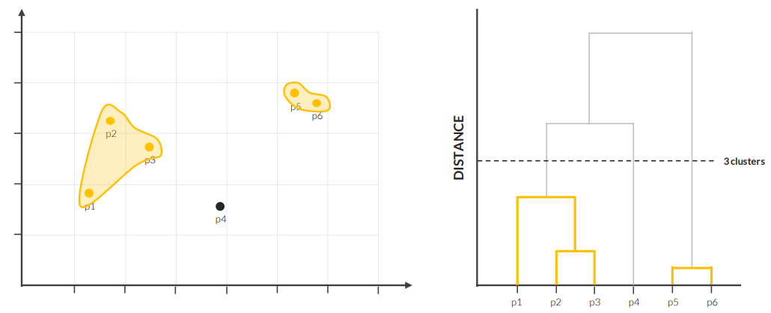
HIERARCHICAL CLUSTERING
STEP 3: Repeat the process until all points are part of the same cluster

Slide 35
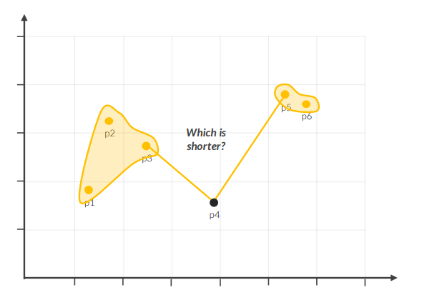
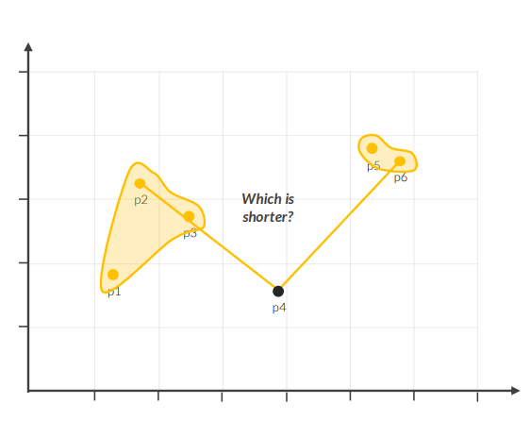
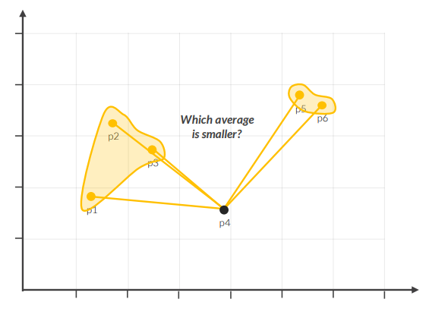
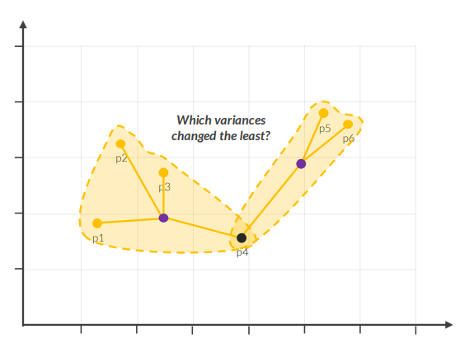
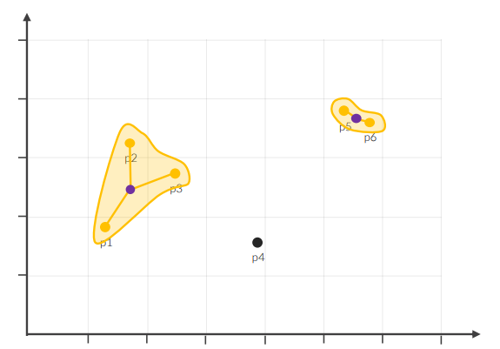
HIERARCHICAL CLUSTERING
STEP 3: Repeat the process until all points are part of the same cluster
How do you define distance between clusters?
Single linkage (closest)
Complete linkage (furthest)
Average linkage (all pairs)
Ward’s method (variance)

Slide 36
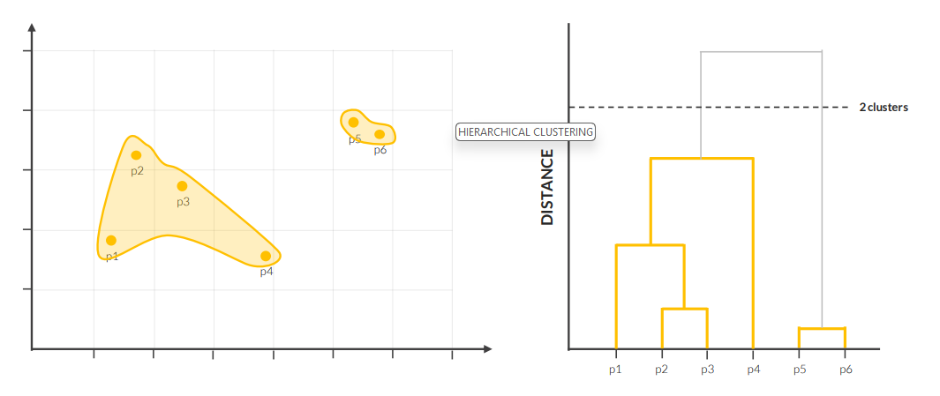
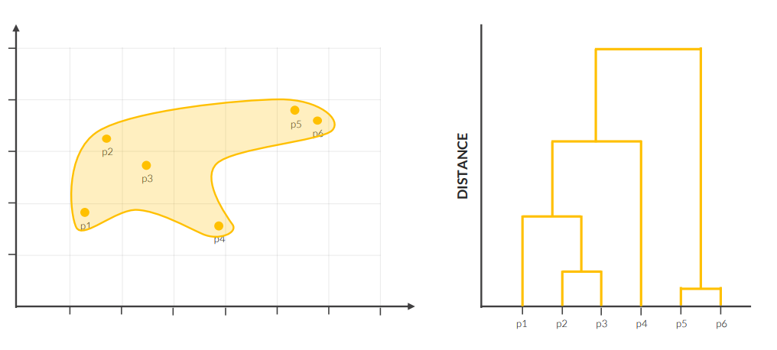
HIERARCHICAL CLUSTERING
STEP 3: Repeat the process until all points are part of the same cluster

Slide 37
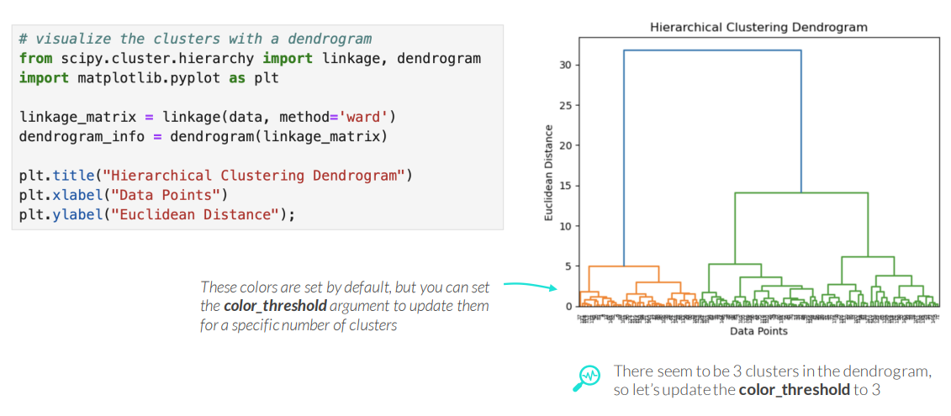
DENDROGRAMS IN PYTHON
The dendrogram() function within the scipy library in Python allows you to visualize Hierarchical Clustering clusters

Slide 38
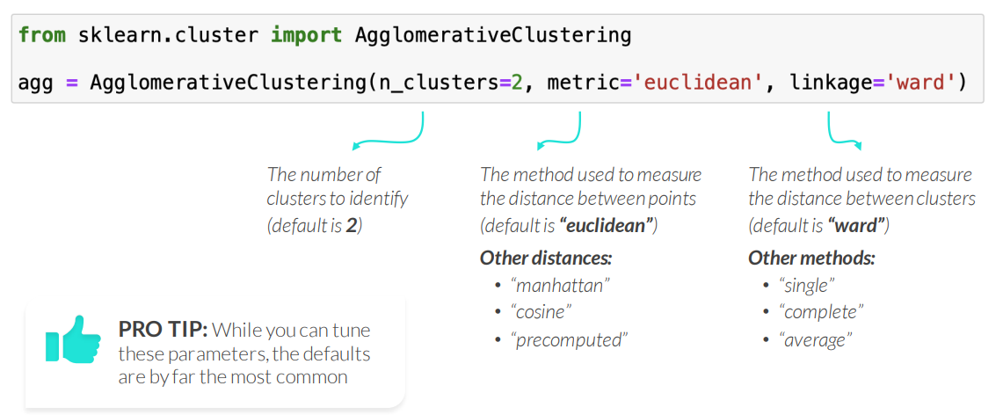
AGGLOMERATIVE CLUSTERING IN PYTHON
The AgglomerativeClustering() function within sklearn’s cluster module allows you to perform Hierarchical Clustering in Python

Slide 39
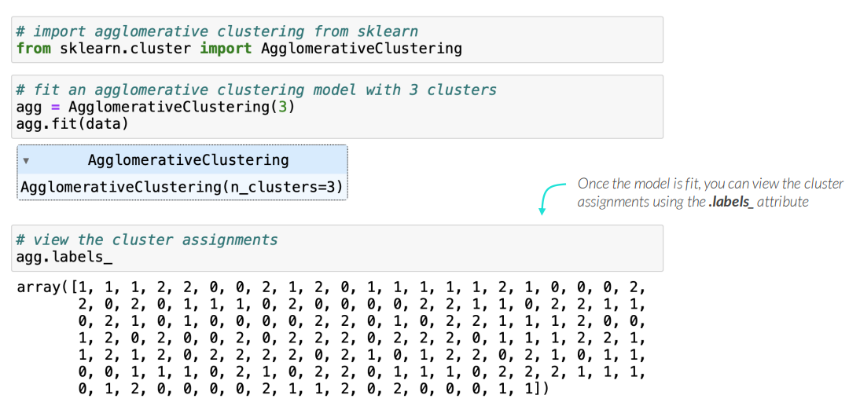
AGGLOMERATIVE CLUSTERING IN PYTHON
The AgglomerativeClustering() function within sklearn’s cluster module allows to perform Hierarchical Clustering in Python

Slide 40
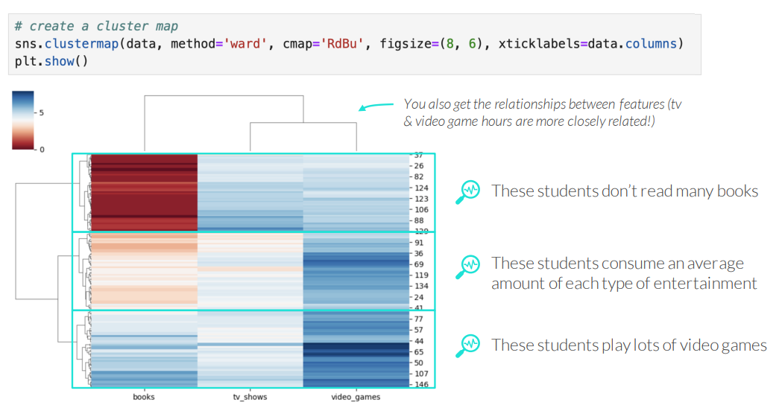
CLUSTER MAPS IN PYTHON
Seaborn’s clustermap() function adds a heatmap on top of the dendrogram, which helps visually interpret each cluster

Slide 41
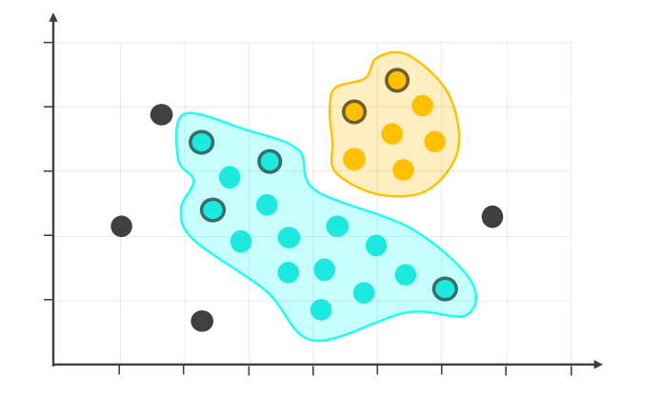
DBSCAN
DBSCAN (Density-Based Spatial Clustering of Applications with Noise) is a clustering technique that identifies clusters based on the density of data points

Slide 42
DBSCAN
DBSCAN (Density-Based Spatial Clustering of Applications with Noise) is a clustering technique that identifies clusters based on the density of data points
Here’s how it works:
Select a radius (eps) and a minimum number of points (min_samples)
Within a scatter plot, label each point as one of the following:
• Core point – has the minimum number of points within its radius (in a dense region)
• Border point – does not have the minimum number of points within its radius, but has at least one core point within its radius (on the outskirts of clusters)
• Noise point (outlier) – does not have a core point within its radius (isolated points)
DBSCAN allows for irregular-shaped clusters and can also identify outliers

Slide 43
DBSCAN DETAILED STEPS
Here are some more detailed steps of how DBSCAN works:
Select a radius (eps) and a minimum number of points (min_samples)
Within a scatterplot, select a point at random and count the points within its radius
• If it’s greater than or equal to the “min_samples”, then start a cluster, label the point as a core point, and mark the points within its radius as a neighbor
• If it’s less than the “min_samples”, label the point as a noise point and move to step 5
3. Move to a neighbor and count the points within its radius
• If it’s greater than or equal to the “min_samples”, label it as a core point, and mark its neighbors
• If it’s less than the “min_samples”, but at least one of them is a core point, label it as a border point • If it’s less than the “min_samples”, and none of them is a core point, label it as a noise point
4. Continue with another neighbor until all the points are labeled within the cluster
5. Move on to another random point and repeat the same steps

Slide 44
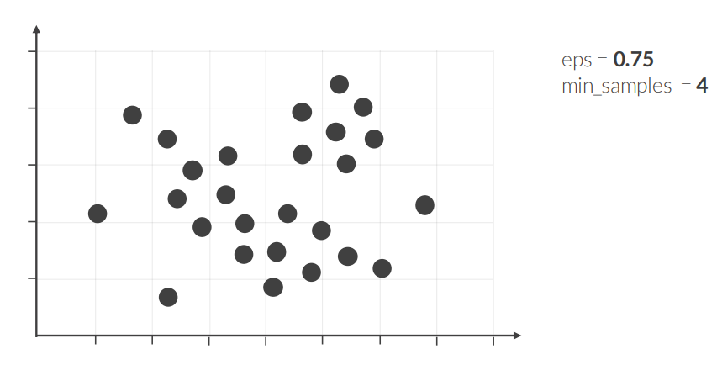
DBSCAN
STEP 1: Select a radius (eps) and minimum number of points (min_samples)

Slide 45


DBSCAN
STEP 2: Select a point at random and count the points within its radius
• If it’s greater than or equal to the “min_samples”, then start a cluster, label the point as a core point, and mark the points within its radius as a neighbor

Slide 46
DBSCAN
STEP 3: Move to a neighbor and count the points within its radius
If it’s greater than or equal to the “min_samples”, label it as a core point, and mark its neighbors

Slide 47


DBSCAN
STEP 3: Move to a neighbor and count the points within its radius
• If it’s less than “min_samples”, but at least one of them is a core point, label it as a border point

Slide 48






DBSCAN
STEP 4: Move on to another neighbor and continue this process until all the points are labeled within the cluster

Slide 49


DBSCAN
STEP 5: Move on to another random point and repeat the same steps

Slide 50

DBSCAN IN PYTHON
Use sklearn’s DBSCAN() to perform DBSCAN clustering in Python
You may have noticed that there is no random_state parameter, even though DBSCAN starts at a random point. This is because sklearn’s implementation of DBSCAN starts at the first point in the data set and moves on from there. You could attempt to get different labels by shuffling the data, but DBSCAN’s labels don’t vary as much as K-Mean Clustering’s labels, so this isn’t as big of an issue.

Slide 51

DBSCAN IN PYTHON
Use sklearn’s DBSCAN() to perform DBSCAN clustering in Python

Slide 52

SILHOUETTE SCORE
While intuition is a large part of comparing clustering models, you can also use metrics like silhouette score to help compare models
• Scores range from -1 to +1, with higher values meaning data points are highly matched to their own cluster and poorly matched to other clusters (which is a good thing!)

Slide 53

SILHOUETTE SCORE
Formula is used to calculate the silhouette score for each data point:

Slide 54

SILHOUETTE SCORE IN PYTHON
Use sklearn’s silhouette_score() function to calculate the silhouette score for the results of a clustering model in Python

Slide 55

CLUSTERING ALGORITHMS RECAP

Slide 56

CLUSTERING ALGORITHMS RECAP
How each clustering algorithms compares on different data sets:

Slide 57
CLUSTERING NEXT STEPS
Once you’ve fit & interpreted your initial models, the potential next steps are to:
1. Compare clustering models
• Silhouette Score: Higher scores closer to 1 mean that clusters are better defined
• Intuition: At the end of the day, the main objective is to answer your business question, so you want to pick the clusters that make the most sense for you to make decisions
2. Label unseen data
• Data Prep: Before labeling unseen data, you must apply the same transformations you applied to the original data set (feature scaling, etc.) when creating the clusters
• K-Means Clustering: The .predict method lets you assign unseen data points to a cluster
• Hierarchical Clustering & DBSCAN: While there is no .predict method for these, you can label unseen data points by re-fitting the models (you may need to update the parameters)

Slide 58

KEY TAKEAWAYS

